Slide 1
Computer Architecture and Networks
Lecturer: Jackie Stewart
Room : X309
Email: jackiestewart@ait.ie
jackie.stewart@tus.ie

Slide 2
What we will cover:
ISO (International Standards Organization) -- OSI(Open System Interconnect) 7-layer model
Explanation of the various layers
TCP/IP 4 Layer model
TCP vs UDP
Web page request and delivery
Network layer functions
Link Layer

Slide 3
ISO/OSI Model
The International Standards Organization (ISO) proposed that computer networks be organized around seven layers, called the Open Systems Interconnect (OSI) model
It is a standard set of rules describing the transfer of data between each layer in a network operating system.
Each layer has a specific function (i.e. the physical layer deals with the electrical and cable specifications)
Notes:
The International Organization for Standardization (ISO) proposed that computer networks be organized around seven layers, called the Open Systems Interconnection (OSI) model.
Later we will see that the Internet Stack (TCP/IP model) lacks two layers found in the OSI model poses a couple of interesting questions.
Are the services provided by these layers unimportant? Or what if an application needs one of these services?
The Internet’s answer to both of these questions is the same – it’s up to the application developer.

Slide 4
ISO/OSI Model
The ISO/OSI Model clearly defines the interfaces between each layer.
This allows different network operating systems and protocols to work together by having each manufacturer adhere to the standard interfaces.
The application of the ISO/OSI model has allowed the modern networks that exist today.
There are seven layers in the OSI model.

Slide 5
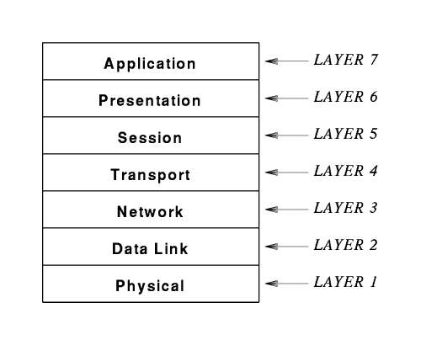
ISO/OSI Model

Slide 6
ISO/OSI reference model
presentation: allow applications to interpret meaning of data, e.g., encryption, compression, machine-specific conventions
session: synchronization, checkpointing, recovery of data exchange
Internet stack “missing” these layers!
these services, if needed, must be implemented in application
needed?
application
presentation
session
transport
network
link
physical
Notes:
Application Layer | Layer 7 | The OSI-Model
https://www.osi-model.com/application-layer/

Slide 7
OSI L7: Application Layer
List some application examples
The Application Layer
Provides the operating system with direct access to network services.
It serves as the interface between the user/host and the network by providing services that directly support user applications
(i.e. software applications that provide a communicating component).

Slide 8
OSI L6: Presentation Layer
Its Role: to provide services that allow communication applications to interpret the meaning of data exchanged.
It is responsible for data translation (formatting), compression, and encryption.
Notes:
The role of the presentation layer is to provide services that allow communication applications to interpret the meaning of data exchanged.
It is concerned with the syntax of data.
Translation
The procedure in two frameworks are generally to exchange the data in the form of character strings, numbers etc. The data must be exchanged into a bitstream before being transmitted.
Encryption
To carry any sensitive data, the presentation layer encrypts the data at the sender's end and decrypts at the receiver's end.
Compression
Compression means the reduction of bits. It is required in the case of multiline text, audio and video.

Slide 9
OSI L6: Presentation Layer
The Presentation Layer is primarily concerned with translation; interpreting and converting the data from various formats.
For example, EBCIDIC characters might be converted into ASCII.
EBCIDIC - a single byte character encoding standard used in the IBM mainframe environment.
It is also where data is compressed for transmission and uncompressed on receipt.
Encryption techniques are implemented at the Presentation Layer.
Notes:
ASCII (American Standard Code for Information Interchange): Computers can only understand numbers, so an ASCII code is the numbericl representation of an character such as “a” or “@” or an action of some sort.
The presentation layer is the lowest layer at which application programmers consider data structure and presentation, instead of simply sending data in the form of datagrams or packets between hosts. The idea is that the application layer should be able to point at the data to be moved, and the presentation layer will deal with the rest.
Serialization of complex data structures into flat byte-strings (using mechanisms such as TLV or XML) can be thought of as the key functionality of the presentation layer.
Encryption is typically done at this level too, although it can be done on the application, session, transport, or network layers, each having its own advantages and disadvantages. Decryption is also handled at the presentation layer. For example, when logging on to bank account sites the presentation layer will decrypt the data as it is received.
A redirection operator is a special character that can be used with a command, like a command prompt command or DOS command, to either redirect the inut to the command or the output from the command.
On a web site, redirection is a technique for moving visitors to a different web page than the one they request, usually because the page requested is unavailable. Web users often encounter redirection when they visit the web site of a company whose name has been changed or which has been acquired by another company.
Within the service layering semantics of the OSI network architecture, the presentation layer responds to service requests from the application layer and issues service requests to the session layer.
Function of presentation layer
The functions of presentation layer are explained below −
Data Compression: It decreases the various bits to be sent by shrinking the data.
Data Conversion: It layouts the data on several hubs according to the software/hardware environment.
Code Conversion: The form and syntax (language) of the two connecting frameworks can be different. One framework uses the American Standard Code for Information Interchange (ASCII) code to document transfer, and the other facilitates the Extended Binary Coded Decimal Interchange Code (EBCDIC) developed by the Computer hardware company IBM. It offers the "translation" from ASCII to EBCDIC and vice versa.
Data Encryption: It encodes information in a particular format so that each user or application cannot understand it.
All the receiver end performs the decomposition, decoding and decryption.

Slide 10
OSI L5: Session Layer
Its Role: provides for delimiting (restricting) and synchronization of data exchange, including the means to build a checkpointing and recovery scheme.
Is responsible for establishing, maintaining, and terminating a connection called a 'session'.
A session is an exchange of messages between computers (a dialog).
Managing the session involves synchronization of user tasks and dialog control (e.g., who transmits and for how long).

Slide 11
OSI L5: Session Layer
The Session Layer
Synchronization involves the use of checkpoints in the data stream.
In the event of a failure, only the data from the last checkpoint has to be resent.
Logon, name recognition and security functions take place at the Session Layer.

Slide 12
OSI L4: Transport Layer
The Transport Layer
On the sending side, messages are packaged for efficient transmission and assigned a tracking number so they can be reassembled in proper order.
On the receiving side, the packets are reassembled, checked for errors and acknowledged.

Slide 13
OSI L4: Transport Layer
The Transport Layer
Performs error handling in that it ensures all data is received in the proper sequence and without errors.
If there are errors, the data is retransmitted.

Slide 14
OSI L3: Network Layer
The Network Layer
It is at the network layer where the route from the source to destination computer is determined.
Routes are determined based on packet addresses and network conditions.
Traffic control measures are also implemented at the network layer.

Slide 15
OSI L2: Data Link Layer
The Data Link Layer
Defines how the signal will be placed on or taken off the NIC.
The data frames are broken down into individual bits that can be translated into electric signals and sent over the network.
On the receiving side, the bits are reassembled into frames for processing by upper levels.

Slide 16
OSI L2: Data Link Layer
The Data Link Layer
Error detection and correction is also performed at the data link layer.
If an acknowledgement is expected and not received, the frame will be resent.
Corrupt data is also identified at the data link layer.

Slide 17
OSI L2: Data Link Layer
The Data Link Layer
Because the Data-Link Layer is very complex, it is sometimes divided into sublayers (as defined by the IEEE 802 model).
The lower sublayer provides network access - (The MAC layer).
The upper sublayer is concerned with sending and receiving packets and error checking.

Slide 18
OSI L1: Physical Layer
The Physical Layer
Establishes the physical characteristics of the network (e.g., the type of cable, connectors, length of cable, etc.)
Defines the electrical characteristics of the signals used to transmit the data (e.g. signal voltage swing, duration of voltages, etc.)
Transmits the binary data (bits) as electrical or optical signals depending on the medium.

Slide 19
ISO/OSI Model
layer-to-layer communication
Application
Application
7
7
Presentation
Presentation
6
6
Session
Session
5
5
Transport
Peer-layer communication
Transport
4
Router
Router
4
Network
Network
Network
Network
3
3
Link
Link
Link
Link
2
2
Physical
Physical
Physical
Physical
1
1

Slide 20
Next the TCP/IP Model
The Internet protocol is a suite of communication protocols.
Wide Area Networks use the Internet Protocol as its protocol stack
Unlike the OSI model, it has 4 layers.
The Internet protocol is commonly referred to the TCP/IP because of the two key protocols it uses i.e. TCP and IP

Slide 21
TCP/IP Model
TCP/IP suite is an end-to-end protocol stack that specifies
how data should be formatted
how data should be Addressed
how data should be transmitted
how data should be routed
how data should be received

Slide 22
TCP/IP Model: 4 Layers
The 4 layers of the TCP/IP model are ( in a top – down approach):
Application Layer
Transport Layer
Internet Layer
Link Layer

Slide 23
Internet protocol stack
application: supporting network applications
FTP, SMTP, HTTP
transport: process-process data transfer
TCP, UDP
network: routing of datagrams from source to destination
IP, routing protocols
link: data transfer between neighboring network elements
Ethernet, 802.111 (WiFi), PPP
physical: bits “on the wire”
application
transport
network
link
physical

Slide 24
ISO Vs. TCP/IP Model
Application
App
Application
Presentation
ASCII/Binary
Session
Transport
TCP
Transport
Network
Network
IP
Link
Link
Ethernet
Physical
The 7-layer OSI Model
The 4-layer Internet model

Slide 25
Terminology at different layers of TCP/IP model
Layer | Term used
Application Layer | Data (a message)
Transport Layer - TCP | Segments
Transport Layer - UDP | datagram
Network layer | packets
Link layer | Frames

Slide 26
TCP/IP Model: Application Layer
The application layer contains all protocols and methods that fall into the realm of process-to-process communications across an Internet Protocol (IP) network.
Application layer methods use the underlying transport layer protocols to establish host-to-host connections.

Slide 27

















Creating a network app
application
transport
network
data link
physical
write programs that:
run on (different) end systems
communicate over network
e.g., web server software communicates with browser software
no need to write software for network-core devices
network-core devices do not run user applications
applications on end systems allows for rapid app development, propagation
application
transport
network
data link
physical
application
transport
network
data link
physical

Slide 28
TCP/IP Model: Application Layer
Examples of Application layer protocols in the TCP/IP model are:
DNS (Domain Name System)
Works on a client server model to address domain name mapping problems
FTP (File Transfer Protocol)
Transfer files between client and server
HTTP (Hypertext Transfer Protocol)
Data communication (WWW)

Slide 29
TCP/IP Model: Transport Layer
Transport Layer provides end-to-end communication services for the applications (from the layer above).
The transport layer comprises of two principal protocols:
Transmission Control Protocol (TCP)
User Datagram Protocol (UDP)

Slide 30
TCP/IP Model: Transport Layer
Transmission Control Protocol (TCP)
Connection orientated transmissions
Guaranteed (logical/physical connection)
User Datagram Protocol (UDP)
Provides connectionless transmissions
Unguaranteed
It’s a best effort policy.

Slide 31


Transport services and protocols
application
transport
network
data link
physical
provide logical communication between app processes running on different hosts
transport protocols run in end systems
send side: breaks app messages into segments, passes to network layer
rcv side: reassembles segments into messages, passes to app layer
more than one transport protocol available to apps
Internet: TCP and UDP
logical end-end transport
application
transport
network
data link
physical

Slide 32
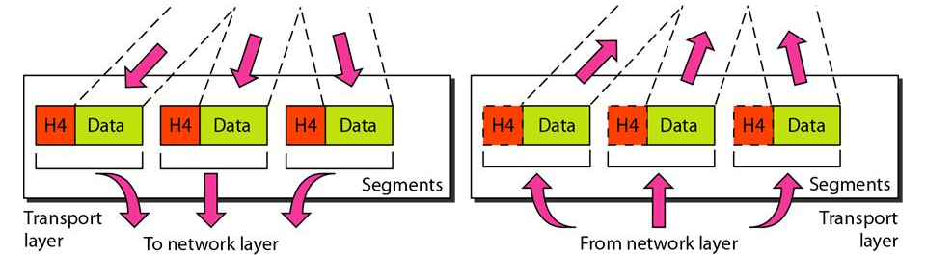
Transport Layer
Primary functions of the transport layer are:
1-- Segmentation and reassembly
The transport layer divides the application data (msg) into blocks of data of appropriate size .
At the destination, the transport layer reassembles the data before sending it to the destination application or service.

Slide 33
Transport Layer
Primary functions of the transport layer are:
2 -- Multiplexing/Demultiplexing
Many applications or services running on each host in the network.
Each application or service is assigned an address known as a port so that Transport layer can determine with which application or service the data belongs to.
Notes:
Two cases can be discussed:
1: connectionless Multiplexing and Demultiplexing
2: Connection oriented Multiplexing and Demultiplexing
Transport layer multiplexing requires:
1: Sockets have unique identifier
2: each segment have special fields that indicate the socket to which the segment should be delivered known as the source port number and destination port number respectively.
When a Host receives the IP datagrams
each datagram has source IP address, destination IP address
each datagram carries one transport-layer segment
each segment has source, destination port number
Host uses IP addresses and port numbers to direct segment to appropriate socket
Demultiplexing:
When host receives UDP segment: (UDP is a connectionless protocol)
it checks destination port number in segment
and directs UDP segment to socket with that port number
IP datagrams with same destination port number, but different source IP addresses and /or source port numbers will be directed to same socket at destination.
TCP (connection oriented protocol) socket is identified by 4-tuple:
source IP address
source port number
destination IP address
destination port number
Demux: the receiver uses all four values to direct segment to appropriate socket
Server host may support many simultaneous TCP sockets:
each socket identified by its own 4-tuple
In contrast with UDP, two arriving TCP segments with different source IP addresses or source port numbers will be directed to two different sockets.

Slide 34
What is Multiplexing and Demultiplexing
Multiplexing
The job of gathering data chunks at the source hosts from different sockets, encapsulating each data chunk with header information to create segments and passing the segments to the network is called multiplexing.
Transport layer multiplexing requires
That sockets have unique identifies
That each segment has special fields that indicate the socket to which the segment data should be delivered to
The special fields used to identify the socket
Source port number
Destination port number
Demultiplexing
At the receiving side the job of delivering the data in the transport segment to the correct socket is called demultiplexing.

Slide 35
Port addresses
Port numbers are assigned by Internet Assigned Number Authority ( IANA)
Port Type | Port numbers
Well known ports ( numbers reserved for services and applications) | 0-1023
Register ports (numbers assigned to user processes or applications, when not used for a server resource, these ports may also be used dynamically selected for client source port) | 1024-49151
Dynamic/private port Usually assigned dynamically to client applications. Not very common for a dynamic or private port to be used on server sider, although some peer-to-peer file sharing programs do | 49152-65535

Slide 36
Transport layer
TCP ( RFC 793) | UDP ( RFC 768)
Connection oriented protocol | Simple connectionless protocol
Additional overhead to support additional functions – header has 20 bytes | Low overheard- header has 8 bytes
Additional Function: Same order delivery
Additional function: reliable delivery
Additional function: flow control

Slide 37
Transport layer - TCP(Transmission Control Protocol)
TCP ( RFC 793)
Connection oriented protocol | Connection set up between server and receiver before any data is transmitted
Reliable delivery | Possible for data to be lost completely as it is transmitted over the network. If this occurs in TCP, the segment is retransmitted
Same order delivery | As data is sent over different routes in the network, it may arrive at destination in wrong order e.g. segment 4 received before segment 3. By numbering and sequencing the segments ,TCP ensures that segments are reassembled in correct order
Flow control | Regulating the amount of data the source transmits. (the window size indicates the amount of data that can be sent before acknowledgment is received. In the period that sender is waiting acknowledgement, the sender will not be sending any data)

Slide 38
Transport layer -TCP
Reliability is the key distinction between TCP and UDP.
Before a host using TCP sends data to another host, the Transport layer initiates a process to create a connection with the destination host.
This ensures that source and destination host are prepared for the communication.
After the connection is established the destination sends acknowledgement to the host for segments it receives
After communication is completed, the connection is closed

Slide 39
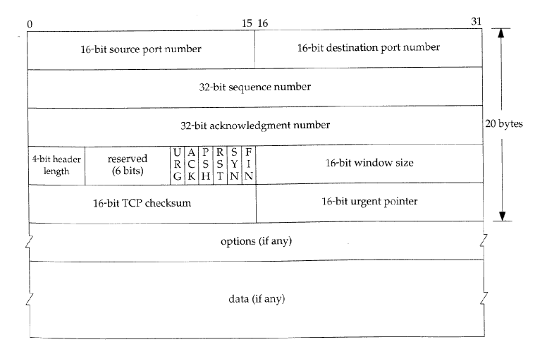
TCP header

Slide 40
TCP – Connection Oriented
TCP connection is said to be connection-oriented because before one application process can begin to send data to another, the two processes must first “handshake”
i.e. they must first send some preliminary segments to each other.
The connection establishment procedure is often referred to as three-way handshake.

Slide 41
TCP – connection oriented
A TCP connection provides for full duplex data transfer.
If there is a TCP connection between process A on one host and process B on another host, then application layer data can flow from A to B and at the same time application layer data can from B to A.

Slide 42
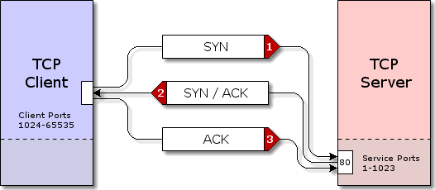
TCP – connection is established before any data is sent

Slide 43
TCP –connection is established before any data is sent
1) A TCP client begins the 3-way handshake by sending a segment with the SYN ( synchronise sequence number) control flag set, indicating the initial value in the sequence number field in the header.
The initial value in the sequence number (ISN) is randomly chosen and is used to begin tracking the flow of data from client to server for the connection.
The sequence number is increase by one for every byte of data sent by the client to the server.
2) The TCP server acknowledges receipt of the SYN segment by sending a segment back to the client with ACK flag set.
The client recognises this as acknowledgement that the server received the SYN from the TCP client
Because the connection is full duplex the server also sets the SYN flag in the segment to establish communication from the server to the client
The SYN flag indicates that the initial sequence number is in the header. This value will be used to track the flow of data from the server to the client.
3) The TCP client responds with a segment that contains the ACK that is the response to the SYN sent by the server.

Slide 44
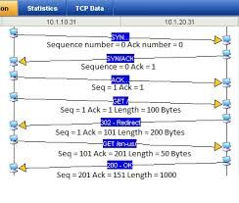
TCP ensures data reliability
An initial sequence number is set during 3-way handshake.
As data is transmitted the sequence number is incremented by the number of bytes that have been transmitted.
The sequence number enables each segment to be uniquely identified.
The segment sequence number and acknowledgement number are used to confirm receipt of the of the bytes of data contained in the segment.
Unacknowledged segments are retransmitted

Slide 45
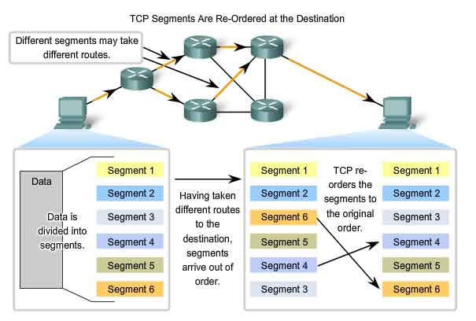
TCP ensures data reliability
The sequence numbers allow each segment to be uniquely identified.
Segment sequence numbers enable reliability by indicating how to reorder and reassemble received segments.

Slide 46
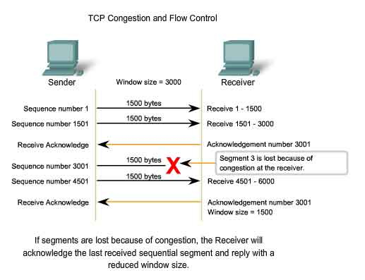
TCP flow control

Slide 47
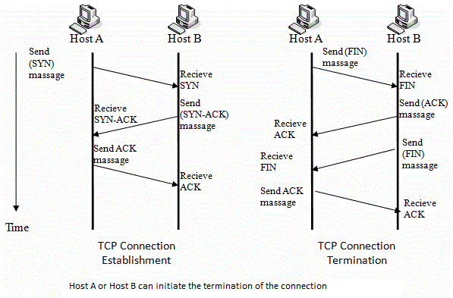
TCP – close down connection

Slide 48
Next is UDP(User Datagram Protocol)
UDP has much lower overhead than TCP.
It is NOT connection-oriented and doesn’t provide for retransmission, sequencing or flow control
This does not mean that applications that use UDP are unreliable, it means that the reliability functions are not provided by the transport layer and must be implemented elsewhere if required.

Slide 49
UDP
As UDP does not have sequence numbers, it reassembles the data in the order it is received.
E.g. if data is received in order of datagram, 1,2,6,5,4..
This is the order in which UDP will reassemble them.
If the sequence of data is important to the application, the application will have to identify the proper sequence of the data and determine how the data should be processed.

Slide 50
UDP
Error checking:
Although UDP does error checking it does not do anything to recover from an error.
Some implementation of UDP just discard the damaged datagram , others pass the damaged datagram to the application with a warning

Slide 51
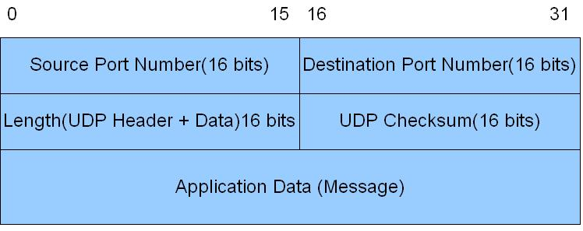
UDP Header

Slide 52
Applications to use TCP or UDP?
Why use TCP at the transport Layer for File transfer?
TCP or UDP?
Time Vs reliability
Application | Application protocol | Transport Layer | Port number
web | http | tcp | 80
File transfer | ftp | tcp | 20 (data), 21 (control)
Name translation | DNS | UDP | 53
Dynamic address allocation | DHCP | UDP | 546 (client) 547 (server)
Internet telephony |  | UDP

Slide 53
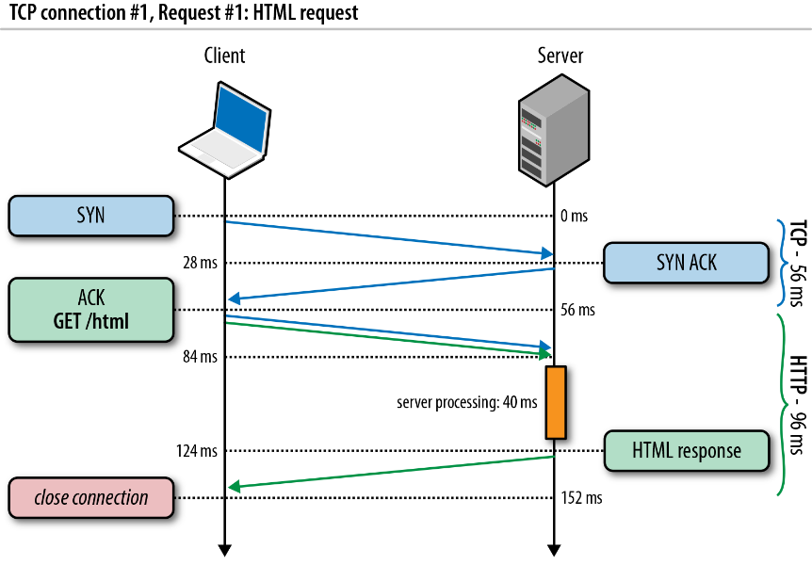
Transfer of web page from server to client
Two connection types: Persistent and non-persistent.
Notes:
TML is the language for describing the structure of Web pages.
HTML gives authors the means to:
Publish online documents with headings, text, tables, lists, photos, etc.
Retrieve online information via hypertext links, at the click of a button.
Design forms for conducting transactions with remote services, for use in searching for information, making reservations, ordering products, etc.
Include spread-sheets, video clips, sound clips, and other applications directly in their doc...
Cascading Style Sheets (CSS) is used to format the layout of a webpage. With CSS, you can control the color, font, the size of text, the spacing between elements, how elements are positioned and laid out, what background images or background colors to be used, different displays for different devices and screen sizes, and much more!

Slide 54
Transfer of web page from server to client
www.tus.ie/engineeringdepartment/home.index
FLOW in the case of a non persistent HTTP connection, HTTP /1.0.
1) HTTP client initiates a TCP connection to the server www.tus.ie on port number 80 (default port number for HTTP)
2) The HTTP client sends a HTTP request message to the server with the established TCP connection The request message includes the path name engineeringdepartment/home.index
3) The server receives the request, retrieves the object engineeringdepartment/home.index, encapsulates the object in a HTTP response message and sends the response message to the client. The HTTP server tells TCP to close the TCP connection . But TCP does not close connection until it knows that HTTP client has received the response
4) The HTTP client receives the response message . The TCP connection terminate
HTTP/ 1.1 , persistent connection, facilitates multiple web object transferred within the life time one connection.

Slide 55
TCP/IP Model: Internet Layer
The Internet Layer (or IP) is based on a set of protocols that are used to transport datagrams (or packets) from a source host to a destination endpoint.
It achieves this based on the destination host being identified by its IP Address.

Slide 56
TCP/IP Model: Internet Layer
The internet layer has three basic functions:
For outgoing packets
Select the next-hop host (gateway)
Transmit the packet to this host by passing it to the appropriate link layer implementation
For incoming packets
Capture packets
Pass the packet payload up to the appropriate transport-layer protocol, if appropriate.
It also provides error checking facilities.
Notes:
Technically, error detection is possible in any layer that has some sort of checksum incorporated in its header.
And it happen to be layer 2, layer 3 and layer 4, because Ethernet and PPP have checksums, IP header has a checksum and TCP/UDP headers have a checksum.
So, you could say that all 3 layers have error detection capabilities.
A checksum is a sequence of numbers and letters used to check data for errors. If you know the checksum of an original file, you can use a checksum utility to confirm your copy is identical.
The Internet checksum: bytes of data are treated as 16-bit integers and summed. The 1s complement of this sum then forms the Internet checksum that is carried in the segment header.
Ones' complement of a binary number is the value gained by inverting all the bits in the binary number. The 1's complement of the number then acts like the negative of the original number in some arithmetic operations.

Slide 57
TCP/IP Model: Internet Layer
Examples of Internet Layer protocols are:
IPV4
IPV6
ICMP (Internet Control Message Protocol) -- (Ping)

Slide 58

Network layer
transport segment from sending to receiving host
on sending side encapsulates segments into datagrams
on receiving side, delivers segments to transport layer
network layer protocols in every host, router
router examines header fields in all IP datagrams passing through it
application
transport
network
data link
physical
network
data link
physical
network
data link
physical
network
data link
physical
network
data link
physical
network
data link
physical
network
data link
physical
network
data link
physical
network
data link
physical
network
data link
physical
application
transport
network
data link
physical
network
data link
physical
network
data link
physical

Slide 59
Two key network-layer functions
network-layer functions:
forwarding: move packets from router’s input to appropriate router output
routing: determine route taken by packets from source to destination
routing algorithms
analogy: taking a trip
forwarding: process of getting through single interchange
routing: process of planning trip from source to destination

Slide 60
TCP/IP Model: Link Layer
Layer 1 of TCP/IP Model is the link layer.
It is protocols that only operate on a host's link.
The link is the physical and logical network component used to interconnect hosts in the network and
a link protocol is a suite of standards that operate between adjacent network nodes of a LAN network segment or a wide area network (WAN) connection.

Slide 61

Encapsulation
source
message
M
application
transport
network
link
physical
segment
H_{t}
M
H_{t}
datagram
H_{n}
H_{n}
H_{t}
M
frame
H_{l}
H_{n}
H_{t}
M
link
physical
switch
destination
H_{n}
H_{t}
M
network
link
physical
M
application
transport
network
link
physical
H_{l}
H_{n}
H_{t}
M
H_{n}
H_{t}
M
H_{t}
M
H_{n}
H_{t}
M
H_{l}
H_{n}
H_{t}
M
router

Slide 62
Summary:
7 layer ISO/OSI Model
Explanation of the various layers
4 Layer model TCP/IP
Terminology
TCP vs UDP
Web page request and delivery
Network layer functions
Link Layer operation

